Slide 1


Java’s Blackjack
and
21 on hand

Slide 2


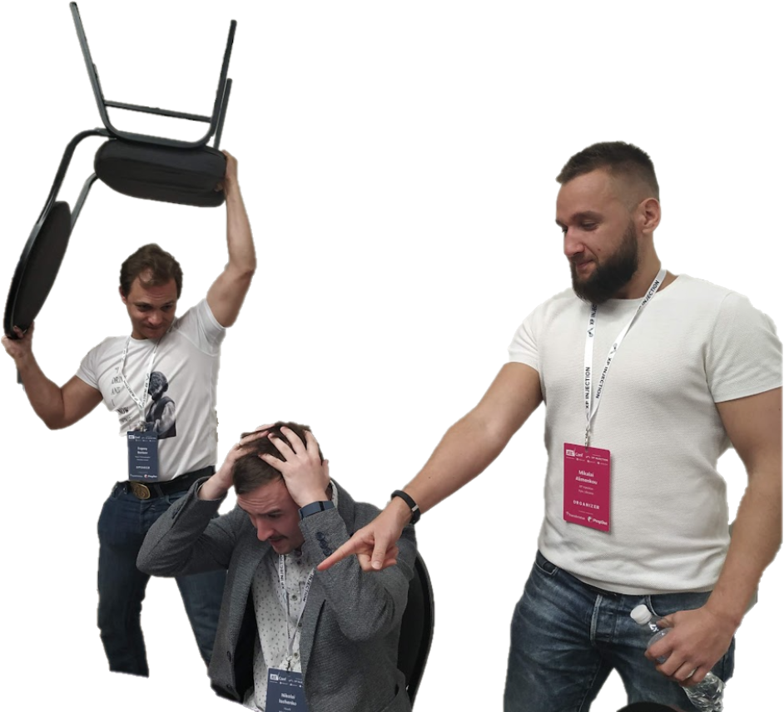

About me:
🎭 Department manager, dev. lead
👨‍💻 In IT > 16 years
☕ With Java > 10 years
🤖 Crazy developer (hobby)
🎤 Speaker
👨 Ischenko Nikolai

Slide 3

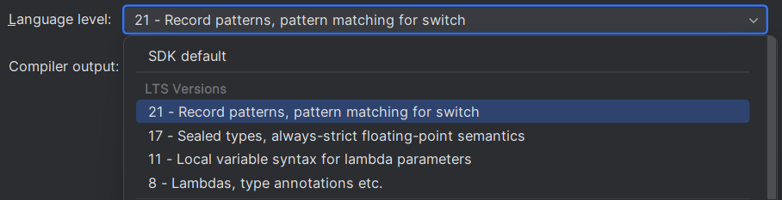
Why and Wat LTS?

Slide 4

Why do we use Java 17 ?
* Released: 09/14/21
🙅 Java 11 isn’t supported yet (Ended in Sep.2023)
⛑️ RedHat OpenJDK is supported till October 2024
🍃 Spring Boot 3 (Spring 6) requires it
🤑 Oracle No-Fee Terms and Conditions [NFTC]
🆕 New Old features
Notes:
git checkout main
Java 11 isn’t supported yet
New Java 17 JEPs since Java 11: https://openjdk.org/projects/jdk/17/jeps-since-jdk-11
Extended support of Java 11 by Oracle: Oracle Releases Java 21 and Extends Support Roadmap
RedHat OpenJDK support: OpenJDK Life Cycle and Support Policy - Red Hat Customer Portal
Spring boot 3
Java trends for 2024: https://www.linkedin.com/posts/coherent-solutions_java-trends-2024-activity-7152589820177833985-IunG?utm_source=share&utm_medium=member_desktop
Spring docs: https://spring.io/blog/2022/11/16/spring-framework-6-0-goes-ga
NFTC
Oracle Java SE Licensing FAQ: https://www.oracle.com/cis/java/technologies/javase/jdk-faqs.html#:~:text=Oracle%20JDK%208%20and%20Oracle,Conditions%20License%20for%20all%20users.

Slide 5
🔡 JEP 378: ”””Text Blocks”””
Java 17 what’s new old?
String cards = """ { "deck": "standard", "cards": [ { "rank": "10", "suit": "Diamonds" }, { "rank": "King", "suit": "Spades" } ] } """;
Notes:
JEP 378: https://openjdk.org/jeps/378

Slide 11
Java 17 what’s new old?
* Released: 09/14/21
⚕️JEP 406: Pattern matching for switch (Preview)
public static String getGameDescription17(CardGameType gameType) { return switch (gameType) { case POKER, BLACKJACK -> "Classic card games"; break; case BRIDGE, RUMMY -> "Strategy card games"; break; case TRICK_TAKING, TRUMPS -> "General trick-taking games"; break; default -> "Other card games"; break; }; }
Notes:
JEP 406: https://openjdk.org/jeps/406

Slide 12


Java 17 what’s new old?
* Released: 09/14/21
Lombok
📹 JEP 395: Record
vs Lombok 🪄
Notes:
JEP 395 Record: https://openjdk.org/jeps/395

Slide 13

Java 17 what’s new old?
* Released: 09/14/21
👥JEP 394: Pattern Matching …for instanceof
Notes:
JEP 394: https://openjdk.org/jeps/394

Slide 14

Java 17 what’s new old?
* Released: 09/14/21
👩‍👧‍👦JEP 409: Sealed classes
… or final with exceptions
Notes:
JEP 409: https://openjdk.org/jeps/409

Slide 15
Java 21 what’s new?
* Released: 09/19/23
Notes:
JEPs in JDK 21 integrated since JDK 17: https://openjdk.org/projects/jdk/21/jeps-since-jdk-17

Slide 16

Java 21 what’s new?
* Released: 09/19/23
🧵JEP 444 (Release): Virtual threads
Notes:
JEP 444: https://openjdk.org/jeps/444

Slide 17

Java 17
SYNCHRONIZED
ASYNCHRONIZED
👍
Programmers know the approach well
👎
Spends resources on working with OS threads
👎
👍

Slide 18
Java 21 Virtual threads
Synchronize
➖ OS threads are limited
➖ Requesting new threads takes time
➕ Programmers know the approach well

Slide 19
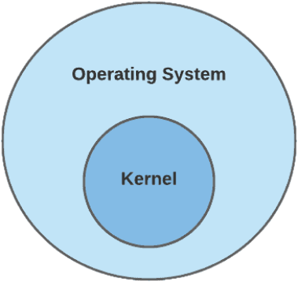

Java 21 Virtual threads
Synchronized approach
➖ OS threads are limited
➖ Requesting new threads takes time
➕ Programmers know the approach well

Slide 20
Java 21 Virtual threads
Asynchronized approach
➖ OS threads are limited
➖ Requesting new threads takes time
➕ Programmers know the approach well

